Slide 1

Big Data Content Analytics
<<Sentiment Analysis on Rotten Tomatoes’s dataset>>
Gkoumas Dimitris
Ntagiantis Dimitris

Slide 2



Sentiment Analysis (aka ‘Opinion Mining’) is the process of identifying and classifying a piece of text to the tone conveyed by it. It is a process that computationally determines whether a piece of writing is positive, negative or neutral or in other words it determines the polarity of the person who wrote that text.
What is Sentiment Analysis ?
Why Sentiment Analysis ?
Politics
Business ,
Public and Social Actions
Fields to apply :
Advantages of Sentiment Analysis
Efficient and cost - effective way of processing data at scale.
Perform real - time analysis.
Improve data consistency and reduce errors.

Slide 3


Challenges of Sentiment Analysis
Challenges of Sentiment Analysis
Detection of subjectivity and tone.
Sentiment without context and changes in the polarity.
Detection of irony and sarcasm.
Analysis on characters (e.g emojis).
Define the meaning of neutral.
Our Case
Rotten tomatoes is an American review – aggregation website for firm and television.
The name "Rotten Tomatoes" derives from the practice of audiences throwing rotten tomatoes when
disapproving of a poor stage performance.
We are going to perform Sentiment Analysis on a “Rotten Tomatoes” dataset in order to extract value from mention and tags, of the movies that this dataset contains, in places like news, blogs and forums.

Slide 4
Dataset’s overview
The Dataset
Train Set
Test Set
- 156.060 rows (reviews)
- 4 columns (info about the reviews’s characteristics)
Just Phrases without their associated Sentiment Labels
- 66.29 rows (reviews)
- 3 columns (info about the reviews’s characteristics)
Phrases and their associated Sentiment Labels
Sentiment Labels
0 → Negative 1 → Somewhat Negative 2 → Neutral 3 → Somewhat Positive 4 → Positive

Slide 5




Which Libraries are we going to use?
We want to develop various types of models for Natural Language Processing like :
Deep Neural Network – The NN classic model – uses the BOW model
Convolutional Network – build a network using 1D Conv Layers – uses word vectors
Recurrent Networks – LSTM Network – Long Short-Term Memory – uses word vectors
Transfer learning for NLP – uses word vectors

Slide 6

Dataset’s Cleaning and Pre – processing
We create a function for cleaning the reviews, tokenize and lemmatize them with the following sequence for each separate phrase :
1. remove html content
2. remove non-alphabetic characters
3. tokenize the sentences
4. lemmatize each word to its lemma
5. return the result in the list named reviews.
Before we start building our model, we have to perform some extra steps to transform our data in a form suitable for our RNN model. These steps are:
1. Collect the dependent values and convert to one-hot encoded output.
2. Split into train and validation datasets.
3. Getting the no of unique words and max length of a review available in the list of cleaned reviews.
4. Tokenizing and converting to sequences.
5. Perform padding to equalize the lengths of all input reviews since LSTM networks needs all inputs to be same length.
6. Define early-stopping threshold to prevent overfitting.

Slide 7

Model’s Architecture and Parameters
In order to train the model, we are going to use a type of Recurrent Neural Network (RNN), known as LSTM (Long Short-Term Memory). The main advantage of this network is that it is able to remember the sequence of past data i.e. words in our case in order to make a decision on the sentiment of the word.
We are going to create the network using Keras. Keras is built on tensorflow and can be used to build most types of deep learning models.
In order to estimate the parameters such as dropout, no of cells etc..., we have performed a grid search with different parameter values and chose the parameters with best performance.
As far as the model’s parameters are concerned, we should focus on three main parameters and explain the values/types selected.
These parameters are : Activation Function, Optimizer and Loss Function .
At this point the Model has been created.

Slide 8
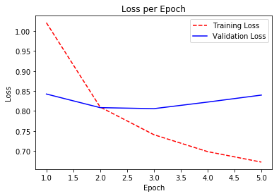
Check the performance of the Model
Visualize the behavior of the learning curve for both train and test set.
Learning curve : a plot of model learning performance over experience or time or more simply, it is a line plot of learning (y-axis) over experience (x-axis) .
Check the model’s accuracy.
Model's average accuracy is equal to 67% approximately, which can be considered a pretty good fit.
The learning curve is not ideal, it should be smoother as it decreases.
At this point, we proceed to the last step of our Sentiment Analysis which is to predict the sentiment of the Rotten Tomatoes users’ reviews and classify them based on the RNN model we built

Slide 9
Goal of this model
Accurate prediction of the sentiment of each phrase in the test set. Our model delivers on its purpose in a big way
Conclusion
Using the model, we built we can extract business value in several ways. The most major ones are the following:
Analyze news articles, blog posts, forum discussions, and other texts on the internet over a period of time to see sentiment of a particular audience.
Automatically categorize urgency of all online mentions to your brand via sentiment analysis.
Automatically alert designated team members of online mentions that concern their area of work.
Automate any or all of these processes.
Better understand a brand (movie/TV show producers) online presence by getting all kinds of interesting insights and analytics.

Slide 10
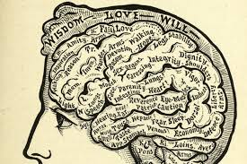
THANK YOU !

